Slide 1
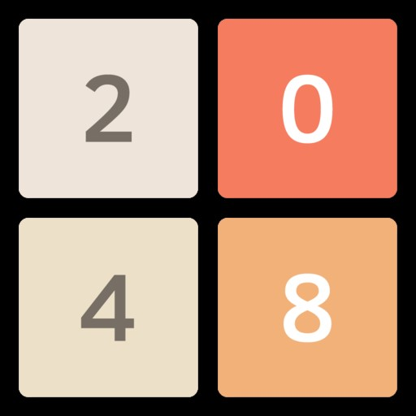
Eat sleep play 2048 & repeat

Slide 2
Introduction
2048 is a single player sliding tile puzzle video game written by Italian web developer Gabriele Cirulli.
Basically, 2048 presents with a 4×4 grid. When you start the game, there will be two “tiles” on the grid, each displaying the number 2 or 4.
You hit the arrow keys on your keyboard to move the tiles around — and also to generate new tiles, which will also be valued at 2 or 4. When two equal tiles collide, they combine to give you one greater tile that displays their sum.
The more you do this, obviously, the higher the tiles get and the more crowded the board becomes. Your objective is to reach 2048 before the board fills up.

Slide 3
Problem Statement
It is a solo player game. In the game 2048, a tile 2 or 4 is generated randomly for a turn. For a given configuration of 4x4 tiles you have to tell the number of moves a player has made assuming that a tile of 2 only was generated on every move. There are some problems, that a user may face, given as:
There are no further levels on this game.
Users cannot see previous score history.
It has to be addressed because the way of focusing and the tactics thar are used normally would be improvised.

Slide 4
objectives
The main objective of this project is development of the simple game with low storage but
not boring, can refresh the mind, helps to release stress with the help of fun environment
which:
Provides new entertaining environment but with old concept.
Optimize the space in the storage unit.
Provides fun for the user and also to improve the focus.
Provides offline mode. For non-internet user the offline mini games are the best for the entertainment purpose.

Slide 5
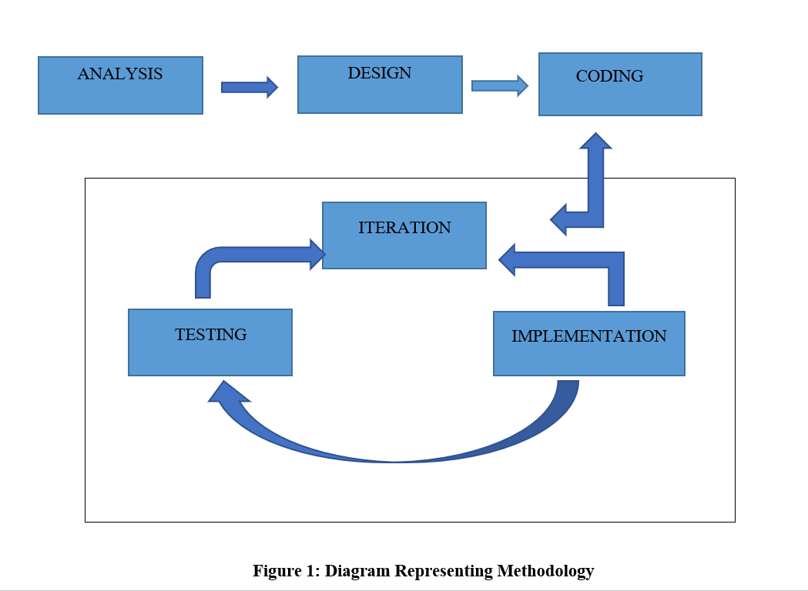
methodology
This approach deals with the development of software which centers around the idea of iterative development, where requirements and solutions evolve through collaboration between self-organizing cross-functional team. The diagram below represents methodology which includes various stages like analysis or coming up with idea. The second stage is designing of project which is followed by coding. Coding includes iteration that ends at the end of program helping in implementation and finally the game is tested and executed and required output comes out.

Slide 6
conclusion
This project was started with modest aim with no prior experience in any programming project as this, but ended up in learning many things.
2048 is simple interactive video game. It is extremely user friendly and has the features, which makes simple graphics project.
Video games are a form of media that is often associated with negative health consequences. However, when games are played in moderation and with mindfulness, they are a viable source of stress relief as well as a catalyst for mental health improvement and development of social skills.
2048 itself is a relatively modern form of entertainment. It is engaging and immersive on a level different from that of traditional board games and other forms of entertainment.

Slide 7
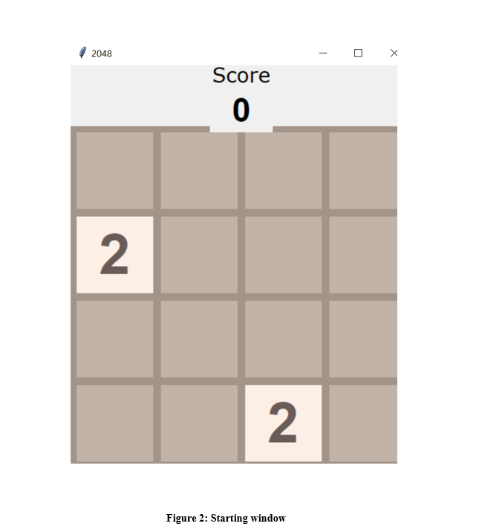
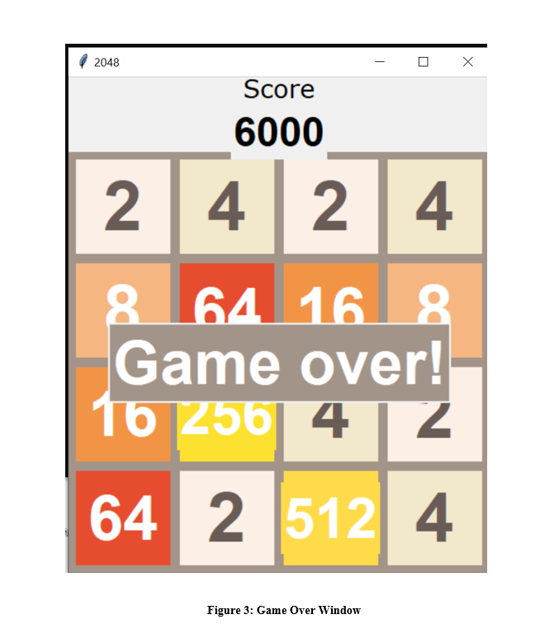
appendix

